Slide 1

ALVA’S INSTITUTE OF ENGINEERING & TECHNOLOGY
A Unit of Alva’s Education Foundation (R)
(Affiliated to VTU, Belagavi. Approved by AICTE, New Delhi
& Recognized by Government of Karnataka)
(Accredited by NBA and NAAC with A+) (ECE & CSE)
Department of Electronics & Communication Engineering
MINI-PROJECT PRESENTATION
ON
“Digital clock with FPGA implementation using verilog”
Presented By:
Supritha HR [4AL23EC101]
Suraksha S Shetty [4AL23EC102]
Umaraj MB [4AL23EC107]
Under the Guidance of:
Mr.Sudhakar H M
Associate Professor
Dept. of E & C E,
Mijar, Moodbidri

Slide 2
CONTENTS
Objective
Problem Statement
Introduction
Literature survey
Methodology
Conclusion/outcome
References

Slide 3
OBJECTIVE
To successfully design, implement, and validate a fully functional 12-hour digital clock on an FPGA using Verilog HDL in Xilinx ISE, capable of accurately generating and displaying real-time hours, minutes, and seconds on seven-segment displays while demonstrating efficient FPGA-based digital system design.

Slide 4
PROBLEM STATEMENT
In today’s digital era, accurate and reliable timekeeping is a critical requirement in many electronic systems. Traditional microcontroller-based clocks often face limitations such as restricted processing speed, timing inaccuracies, and reduced efficiency.
FPGA-based design provides a more robust solution by offering high-speed operation, precise timing control, and reconfigurable hardware.
In this project, a real-time 12-hour digital clock was successfully designed and implemented using an FPGA board and Verilog HDL, achieving high precision, efficient hardware utilization, and reliable time display on seven-segment outputs.

Slide 5
INTRODUCTION
The Digital Clock using FPGA system is a successfully completed project that designs and implements a 12-hour format digital clock on an FPGA board using Verilog HDL in Xilinx ISE. The project demonstrates the practical working of FPGA-based digital systems for accurate real-time applications.
The clock accurately displays hours, minutes, and seconds on seven-segment LED displays.
FPGA hardware enables high-speed, parallel processing for improved performance.
The system ensures precise and reliable real-time operation.
The project enhances understanding of digital design, simulation, and hardware implementation on FPGA devices.
Overall, it showcases the efficiency, flexibility, and superiority of FPGA-based systems compared to traditional microcontroller-based clocks.

Slide 6
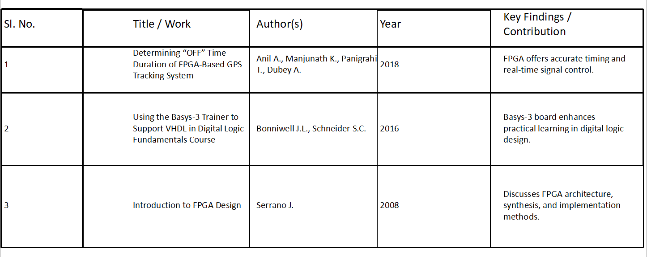
LITERATURE SURVEY
The literature survey work is summarized in Table I.
TABLE I. SUMMARY OF THE LITERATURE REVIEW.

Slide 7
METHODOLOGY
The system is designed to display real-time time information using an FPGA board and Verilog HDL, where the FPGA efficiently handles all timing, counting, and display operations through parallel processing. The design uses hardware-based counters and clock dividers to achieve accurate timekeeping, and a seven-segment display interface to show the current time in a 12-hour format.
Steps:
The FPGA generates a 1 Hz real-time clock pulse.
Separate counters track hours and minutes in 12-hour format.
Seven-segment display decoders convert binary values to display patterns.
SET inputs allow manual adjustment of time.
Simulation confirms correct functioning before hardware implementation.
Once programmed on the FPGA board, the clock displays the current time accurately on four seven-segment displays.

Slide 8
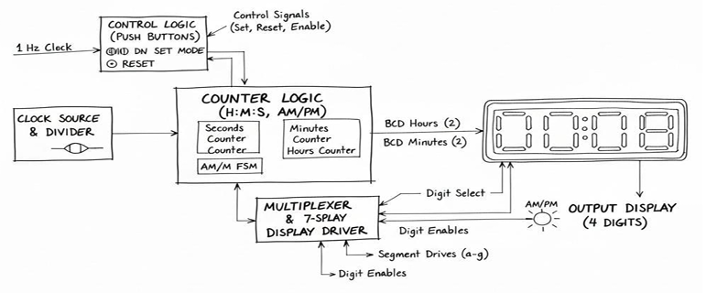
Block Diagram:

Slide 9
SOFTWARE AND TECHNOLOGY
🔹 Software Tools
Vivado Design Suite (Xilinx):Used for writing, simulating, synthesizing, and implementing Verilog HDL code on the FPGA board.
Verilog HDL:Hardware Description Language used to design the clock logic, conversion, and display modules.
Xilinx ISE Constraint Editor:For mapping FPGA pins and defining hardware connections.
🔹 Hardware Technology
FPGA Board (Xilinx Artix-7):Used as the main hardware platform for implementation and testing.
7-Segment LED Display:To show real-time hours and minutes in digital format.
Push Buttons & Switches:For setting time and controlling clock functions.

Slide 10
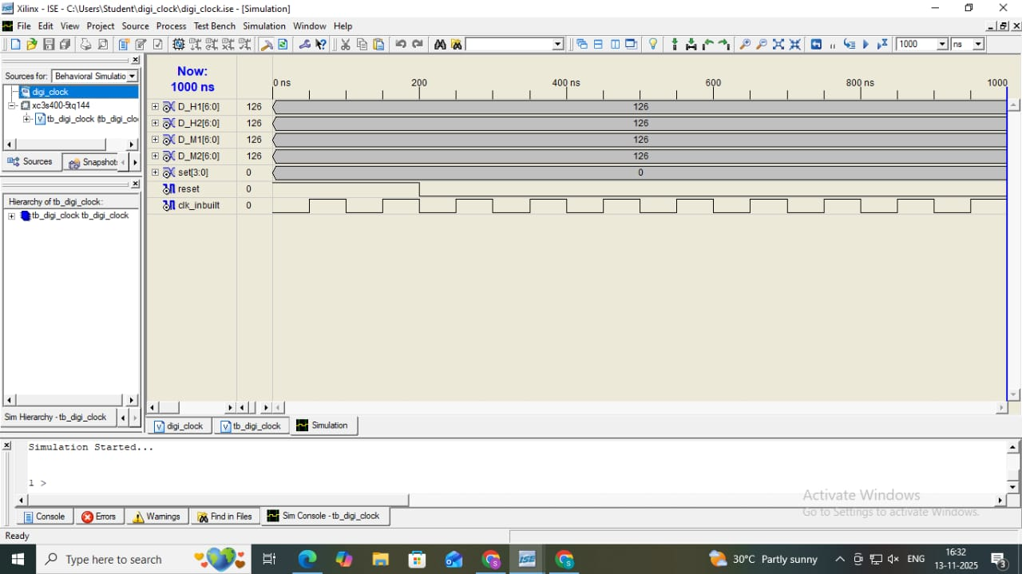
RESULTS AND IMPLEMENTATION OUTPUTS
Successfully implemented a fully functional 12-hour digital clock on the FPGA board using Verilog HDL.Generated an accurate 1 Hz clock pulse through clock division for real-time timing.
Implemented counters for hours, minutes, and seconds, tested through simulation and hardware.Designed and used 7-segment display decoders to show time in HH:MM:SS format.Verified functionality through ModelSim/Vivado simulation, confirming correct time transitions.
Hardware testing on FPGA showed accurate and stable time display with smooth setting.Integrated manual time-setting controls using push buttons/switches.Demonstrated advantages of FPGA design: parallel processing, timing accuracy, and reconfigurable hardware.

Slide 11
CONCLUSION/OUTCOME
The Digital Clock with FPGA Implementation project successfully demonstrates how digital logic and FPGA technology can be combined to create an accurate, efficient, and reconfigurable real-time system.
Using Verilog HDL on the FPGA board, the design performs precise timekeeping with hour, minute, and second display on 7-segment LEDs.
The system highlights the advantages of FPGA-based design such as high-speed parallel processing, hardware flexibility, and improved timing accuracy.
The project enhances practical understanding of digital design, simulation, and synthesis, promoting the use of FPGA technology in modern embedded systems.

Slide 12
REFERNCES
[1] Determining off time duration of FPGA basec GPS tracking systemAnil, A., Manjunath, K., Panigrahi,
T., & Dubey, A. (2018, October). Determining" OFF" Time Duration of FPGA basec GPS Tracking System. In 2018 Conference on Information and Communication Technology (CICT) (pp. 1-5). IEEE.
https://doi.org/10.1016/j.rineng.2025.104945.
[2] Using the Basys-3 trainer to support VHDL in digital logic fundamentals course Bonniwell, J. L., & Schneider, S. C. (2016, October). Using the Basys-3 trainer to support VHDL in digital logic fundamentals
course. In 2016 IEEE Frontiers in Education Conference (FIE) (pp. 1-4). IEEE.
https://doi.org/10.1016/j.protcy.2014.09.056.
[3] Introduction to FPGA designSerrano, J. (2008). Introduction to FPGA design.
https://doi.org/10.1016/j.snr.2025.100302
[4] A Review of Design of Digital Clock Based on Verilog HDL. Li, W., Li, S., Zeng, Q., & Zhou, C. (2023). A Review of Design of Digital Clock Based on Verilog HDL. Highlights in Science, Engineering and Technology, 46, 289-297.
https://doi.org/10.1016/j.prime.2023.100115

Slide 13


